Slide 1

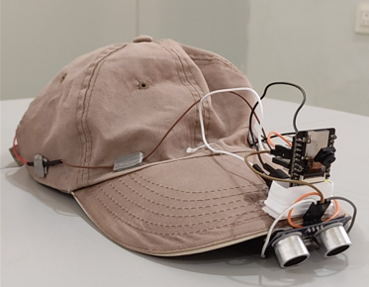
ACCS DESIGN CHALLENGE 2024
“NAV-DRISHTI”: Indoor Navigation System for
Visually Impaired Individuals.

Slide 2
TEAM ID
ADC2024489
OUR TEAM
Ujwal Shanbhag
Karthik Gunda
Tanmay Kulkarni
Amogh Bhat
UNIVERSITY
KLE TECHNOLOGICAL UNIVERSITY HUBBALLI,KARNATAKA
TEAM MENTOR
Dr.Ujwala Patil

Slide 3
INTRODUCTION
CONTENTS
HARDWARE ARCHITECTURE
SOFTWARE
ARCHITECTURE
RESULTS
CONCLUSION

Slide 4

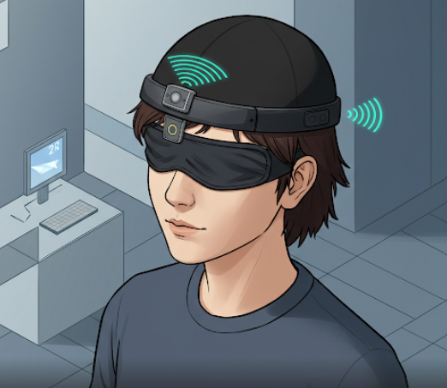
INTRODUCTION
Navigating indoor spaces poses significant challenges for visually impaired individuals due to the absence of reliable and accessible navigation systems.
There is a need for an affordable, scalable, and accurate indoor navigation system that enables visually impaired individuals to move independently, avoid obstacles, and access real-time navigation assistance.

Slide 5
INTRODUCTION
WHY IS IT ESSENTIAL?
Visually impaired individuals face significant challenges navigating large indoor spaces, like malls, hospitals, airports, and offices.
Statistics based on the 43.3 million visually impaired individuals worldwide, with only 2% using guide dogs and most relying on canes, highlight the critical need for innovative indoor navigation solutions.
CHALLENGES ASSOCIATED WITH CURRENTLY EXISITING SOLUTIONS
Smart canes help detect objects below waist level, but cannot detect objects above the waist.
Carry-on-robots are expensive, bulky and have high maintenance cost.

Slide 6
INTRODUCTION
Hence, we introduce “NAV-DRISHTI”, an innovative indoor navigation system designed specifically for visually impaired individuals.
OBJECTIVES
Develop an affordable and scalable Indoor Navigation System (INS) for visually impaired individuals.
Implement IMU and BLE-based trilateration for precise location tracking.
Provide accurate real-time navigation assistance using voice feedback.
Integrate object detection for obstacle avoidance.

Slide 7
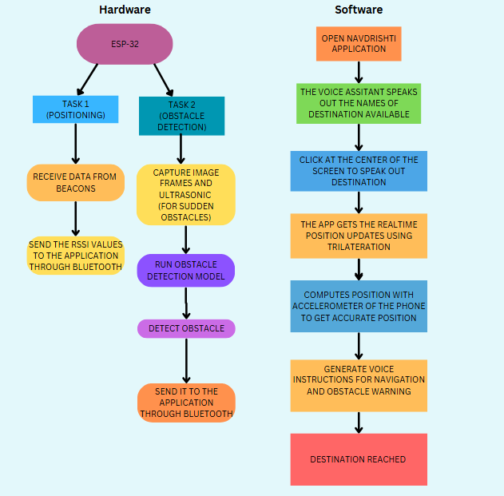
SYSTEM
ARCHITECTURE

Slide 8
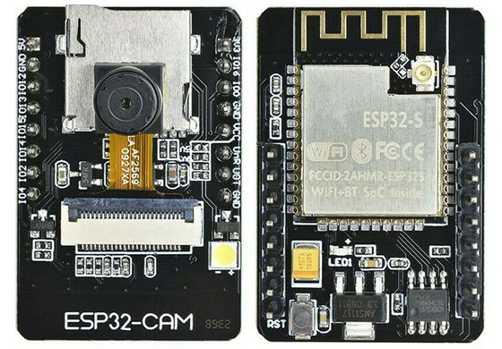
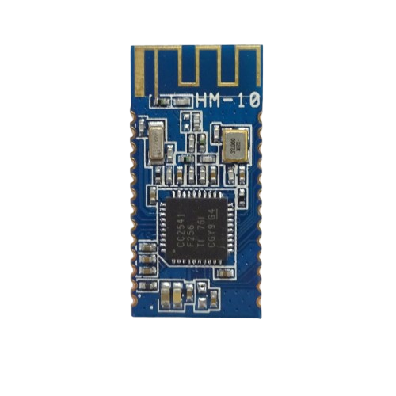
HARDWARE CHOSEN
Hardware Selection
MICROCONTROLLER USED: ESP32 CAM MODULE
Cost Effective and Compact Size:Highly affordable (₹600 per unit) while providing all the necessary features for real-time BLE scanning.
Camera Connectivity:The OV2640 can be easily connected to the ESP32.Thus facilitating obstacle detection module.
BLUETOOTH BEACON USED: HM10
Cost effective: Compared to other BLE modules (like Nordic nRF series or iBeacon hardware), the HM-10 is relatively inexpensive, making it a good choice for large-scale deployment.
Provides a reliable range of up to 50 meters in open space and is suitable for indoor positioning without excessive power usage.

Slide 9
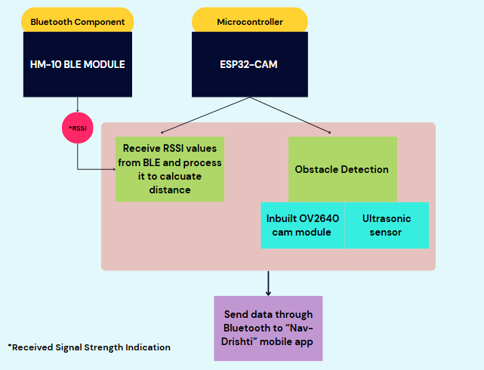
HARDWARE ARCHITECTURE

Slide 10
PERFORMANCE ANALYSIS OF OBJECT DETECTION ON ESP32
A lightweight model fomo (faster objects, more objects) mobilenetv2 0.35 trained on esp32 microcontroller for object detection
Classes trained on :1)Standing Human 2)Chair
Latency | Ram Usage | Flash Usage | Accuracy
15 ms for image preprocessing 833 ms for object detection 848 ms in total | 4.0 KB for image preprocessing 239 KB for object detection 243 KB in total | 79 KB for storing the model | 71%
Performance metrics

Slide 11
ENERGY CONSUMPTIONS
Battery Life Analysis for HM-10 and ESP32-CAM with 3.7V, 2000mAh Li-ion Battery
Power Consumption Overview
Battery Capacity: 2000mAh
Voltage: 3.7V
HM-10
Active Mode Consumption: 20mA for 20ms per second
Battery Life​≈2247 hours(93.6 days)
ESP32-CAM
Active Mode Consumption: ~240mA (CPU at 240 MHz)
Battery Life : 8.33 hrs

Slide 12
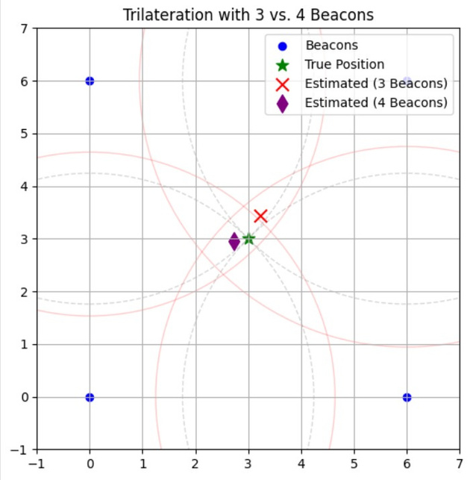
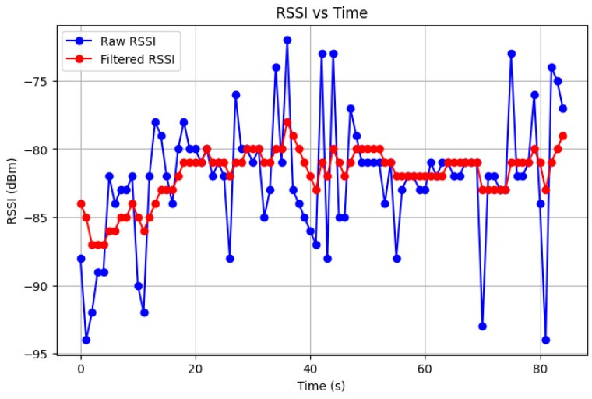
OPTIMIZING HARDWARE RESOURCE UTILIZATION AND IMPROVING ACCURACY
Comparative analysis of RSSI with and without Kalman filter
Quantification of beacons
True Position: [3 3]
Estimated Position (3 Beacons): [3.23536358 3.43507727], Error: 0.49
Estimated Position (4 Beacons): [2.72250862 2.95628311], Error: 0.28
Mean Absolute Error (MAE): 2.68 dB
Mean Error Difference (MED): 0.31 dB
Variance (Raw RSSI): 20.64
Variance (Filtered RSSI): 3.67

Slide 13
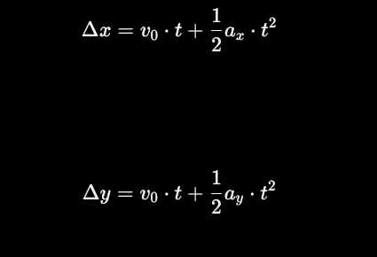
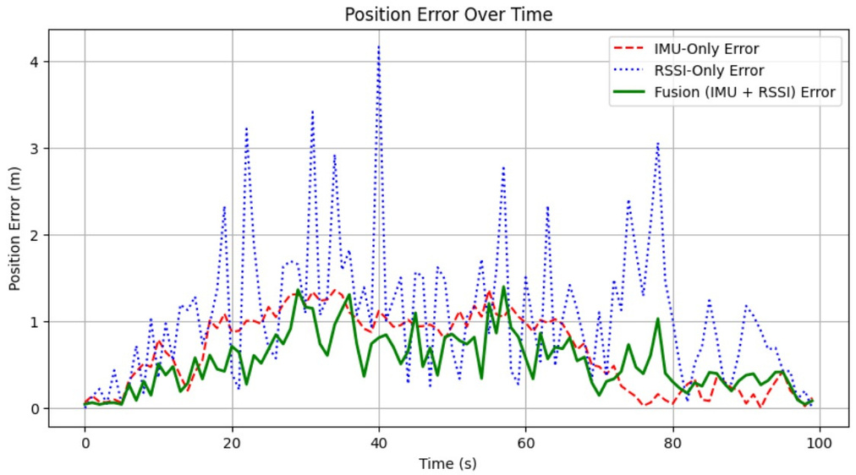
NAVDRISHTI ALGORITHM
TRILATERATION BASED DELTA X AND DELTA Y CALCULATION
KINEMATIC MOTION MODELLING USING
ACCELEROMETER OF THE MOBILE PHONE
Mean Absolute Error (MAE): IMU = 0.66, RSSI = 1.08, Fusion = 0.54
Root Mean Square Error (RMSE): IMU = 0.79, RSSI = 1.34, Fusion = 0.63
Mean Error Difference: IMU-RSSI = 0.60, Fusion-IMU = 0.25, Fusion-RSSI = 0.64

Slide 14
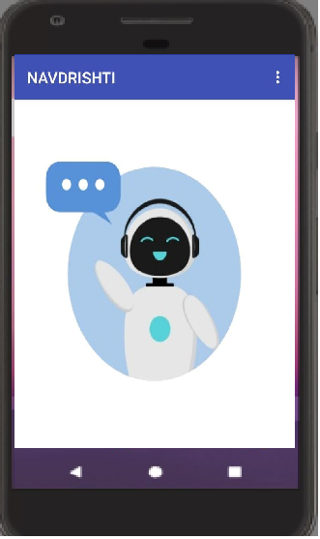
SOFTWARE ARCHITECTURE
i)Bluetooth Communication
The app uses Bluetooth to receive data from the ESP32.
Object detection results and RSSI values data are transmitted via BLE.
ii)Data Processing
The app processes the received data to identify detected objects and calculate user
position.
It applies NavDrishti algorithms for determining the best path.
iii)Voice Assistance
Text-to-speech (TTS) is used to generate real-time voice commands.
The app provides clear navigation guidance and obstacle alerts.
The mobile application was developed using MIT App Inventor, providing an intuitive
and user-friendly interface for real-time voice assistance and navigation support.

Slide 15
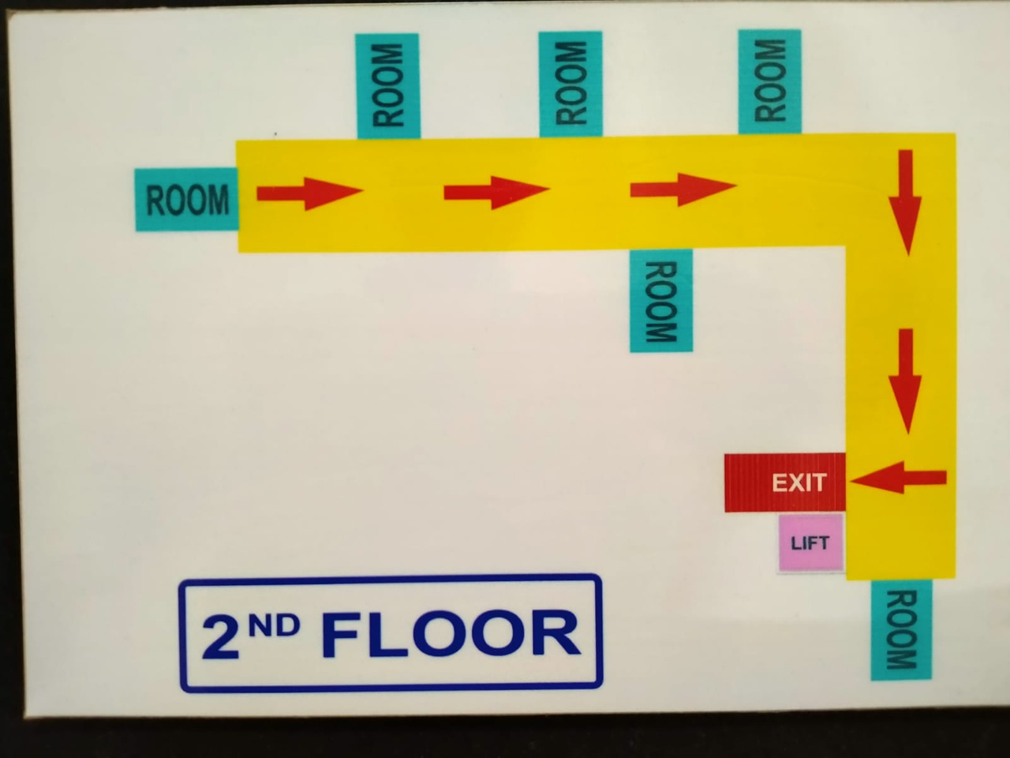
DEMONSTRATION
Basic Path
From room 1 to elevator

Slide 16
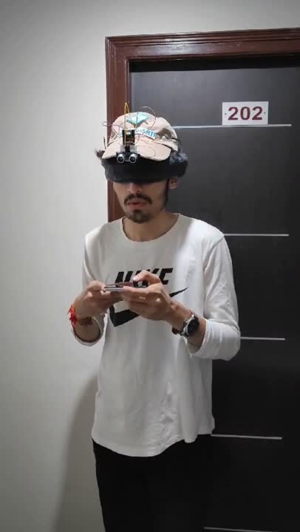
DEMONSTRATION
Basic Path
From room 1 to elevator

Slide 17

CONCLUSION
By leveraging Bluetooth beacons and IMU sensors, the system ensures reliable indoor positioning with minimal drift, enhancing user confidence.
The lightweight FOMO model on the ESP32 enables real-time identification of obstacles like chairs and humans, while ultrasonic sensors provide additional safety like walls.
Nav Drishti prioritizes accessibility and independence for visually impaired individuals, offering a scalable and cost-effective solution for safer indoor navigation
FUTURE PLANS
Smartphone Independence: Enhance the Nav Drishti system by integrating a DSP IC with the ESP32, allowing direct microphone and speaker management. A preloaded map stored on an SD card will enable offline navigation without the need for a smartphone.
OCR for Vision Assistance: Develop an Optical Character Recognition (OCR) feature to assist visually
impaired individuals in reading printed text. This will further empower users to access written information .

